Slide 1
APRICOT: Attentive parental education for wise being and co-being in changing times
2019-1-LT01-KA204-060481
Misinformation and Disinformation
Quiz 2: Spot the Difference: Fact or Fake?
(for 11-13 year old children to do with their parents/grandparents/carers)

Slide 2
Helping children develop online critical thinking
Why?
While the digital world offers a range of information and opportunities for young people, it is also becoming harder to separate fact from fiction.
As children are spending more time online and constantly making decisions of what to trust, it’s now more important than ever for them know how influence, persuasion and manipulation can impact their decisions, opinions and what they share online.
Can you find the fake online?
We suggest you play this quiz as a family (parents with children) to learn and test your knowledge on what fake news, disinformation and misinformation is, and how to stop it from spreading.
There are 5 questions, each followed with the opportunity to learn more and discuss.

Slide 3
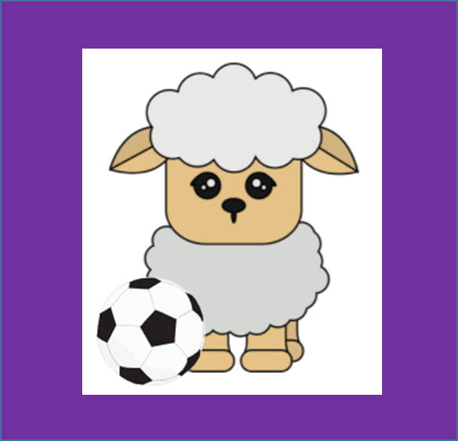
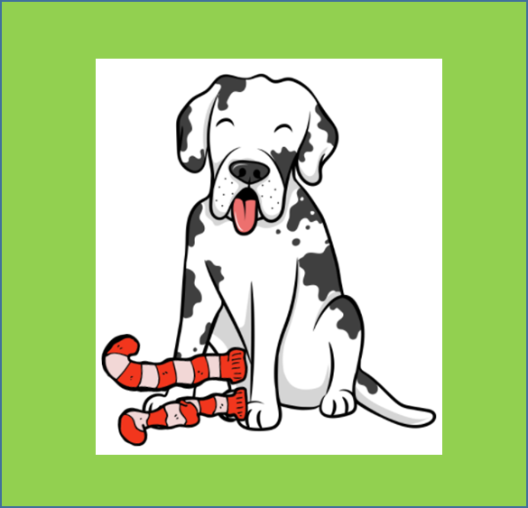
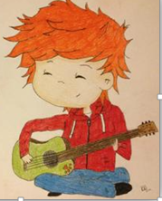
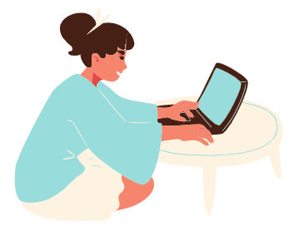
Q1. Read the captions below and select the one you think is fake. Pick 1 answer below
You aren’t ready for this football playing sheep!
[published on Animulsport.ku.com]
Surgery reveals Oregon Great Dane ate 43 socks
[published on nbcnews.com]
11-year-old left with mum’s laptop blows $1223 on Ed Sheeren tickets
[published on nzherald.co.nz]
Choose this answer
Choose this answer
Choose this answer

Slide 4
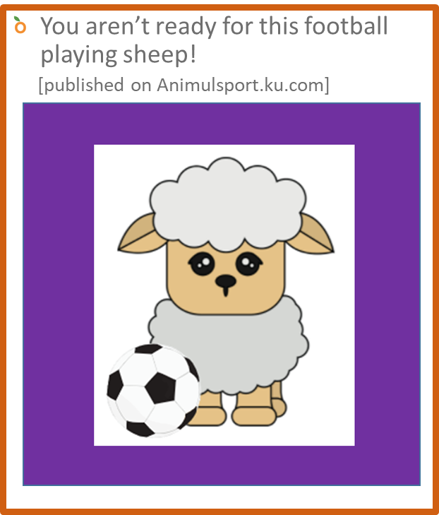
Results: Here is how you did
Qusetion 1: Read the captions below and select the one you think is fake
Your answer was correct.
You got it right – do you know why?
There is no such website!
It can be quite difficult to figure out whether something is true simply by reading the headline, that’s why it’s important to read the whole article to get the whole story and/or check it out.
Also, if it sounds like it could be fake, do your research.
The other two were actually real – strange but true!
Find out more

Slide 5
Q1. Learn More
If you are unsure whether a story is fake or not:
1. Read it – Look for unusual URLs or site names – these are often trying to appear like true news sites, but they aren’t. Look for signs of grammar or spelling errors, no source links or clickbait images.
2. Check it – Who wrote it? You can check the author on the page or go to the ‘about us’ or contact pages to see who is the person or the organisation. You can also do a Google search to see what else you can learn about this person or organisation from other sources to check if they are who they say they are.
3. Feel it – How does it make you feel? People who make false news try to manipulate your feelings. Just because something has been shared on social media many times doesn’t mean it’s true. If something looks too good to be true, it probably is.
4. Wait – Just because something has been shared on social media many times doesn’t mean it’s true. If something looks too good to be true, it probably is.
Notes:
Fact checking websites by country:
Germany
www.Volksverpetzer.de , launched by Thomas Laschyk
www.Correctiv.org , launched by "Recherchen für die Gesellschaft gemeinnützige GmbH“
Lithuania
www.Demaskuok.lt and www.Debunk.eu: launched by Delfi and other Lithuanian online media.
Spain
www.Miniver.org First dedicated fact-checking web in Spain, launched in 2017, with the purpose of debunking fake news. Accredited by Google as fact-checking organization.
www.newtral.es Newtral - Spanish fact-checking organization. Currently the official news verifier for Facebook Spain
www.Maldita.es Independent Spanish fact-checking organization.

Slide 6
Q1. DISCUSSION
Before you move on to the next question, discuss the following to think about your own experiences:
Have you come across any weird headlines online that sounded made-up? What did you do when you saw them?
Next Question

Slide 7
Results: Here is how you did
Question 1: Read the captions below and select the one you think is fake.
Your answer was not correct.
This is the fake caption. The one you chose was actually real – strange but true!
Read it again. Now can you see why it’s fake?
There is no such website!
It can be quite difficult to figure out whether something is true simply by reading the headline, that’s why it’s important to read the whole article to get the whole story and/or check it out.
Also, if it sounds like it could be fake, do your research.
Find out more

Slide 8
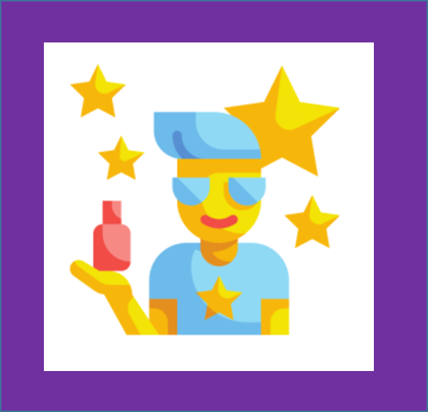
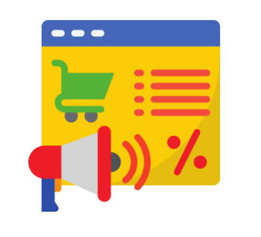
Q2. What is the definition of a clickbait ad? Pick 1 answer below
An ad that helps you find good quality product information online
Something that you can buy to improve your fishing
An ad that uses fake videos, celebrity news or sensationalised headlines to entice you to another website
Choose this answer
Choose this answer
Choose this answer

Slide 9
Q2. Results: Here is how you did
Question 2: What is the definition of a clickbait ad?
Your answer was correct.
Yes, the correct answer is:
An ad that uses fake videos, outrageous claims, celebrity news, sensationalised headlines, a ‘too good to be a true’ contest or celebrity news to get you to click through to another website.
Find out more

Slide 10
Q2. Learn more
If you click on clickbait ads they can take you to websites that are filled with more ads. These may contain harmful content (not for kids) or to articles that make false claims.
Although they are difficult to ignore (even for adults), try not to click on them to avoid seeing content you shouldn’t.

Slide 11
Q2. DISCUSSION
Before you move on to the next question, discuss the following whilst thinking about your own experiences:
Can you remember if you’ve seen a clickbait ad?
What did it say that made you click on it?
What would you do now that you know what to look out for?
Next Question

Slide 12
Q2.Results: Here is how you did
Question 2: What is the definition of a clickbait ad?
Your answer was not correct.
The correct answer is:
An ad that uses fake videos, outrageous claims, celebrity news, sensationalised headlines, a ‘too good to be a true’ contest or celebrity news to get you to click through to another website.
.
Find out more

Slide 13
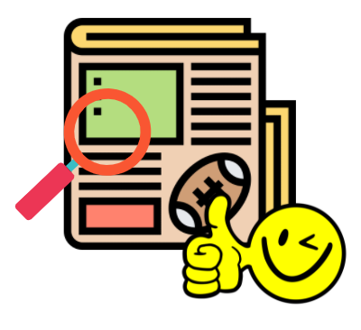
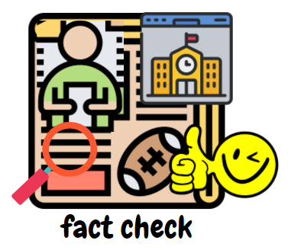
Q3: Which of these things would you do to check if something was real online? Pick 1 answer below
Look at the whole piece of content not just the headline to see if there are things that seem out of place
Check out the source to see if they are trustworthy (e.g government or school website or trusted news site)
Do a search to see what other people are saying about it to make sure it matches up
All of these options!
Choose this answer
Choose this answer
Choose this answer
Choose this answer

Slide 14
Q3 Results: Here is how you did
Question 3: Which of these things would you do to check if something was real online?
Your answer was correct.
Yes, the correct answer is:
All of these Options!
You should:
Look at the whole piece of content not just the headline to see if there are things that seem out of place
Check out the source to see if they are trustworthy (e.g government or school website or trusted news site)
Do a search to see what other people are saying about it to make sure it matches up
Find out more

Slide 15
Q3. Learn and Discuss
If you thought all of them were the right - you are correct!
There are a range of things you can do to see if something should be trusted but the most important thing to remember is to question something first before making up your mind.
The trouble is, it can be easy to trust something when you first see it, particularly if it fits in with what we believe; but sometimes those things can be untrue or misleading.
Use your Critical Thinking Skills, read it and check it – and then (most of the time!) you won’t be fooled.

Slide 16
Q3. DISCUSSION
Before you move on to the next question, discuss the following to think about your own experiences:
What if your friends were convinced that something was real but you could see that it was fake? How would you show them that they may be wrong?
Next Question

Slide 17
Q3 Results: Here is how you did
Question 3: Which of these things would you do to check if something was real online?
Your answer was not correct.
The correct answer is:
All of the options are right!
Look at the whole piece of content not just the headline to see if there are things that seem out of place
Check out the source to see if they are trustworthy (e.g government or school website or trusted news site)
Do a search to see what other people are saying about it to make sure it matches up
Find out more

Slide 18
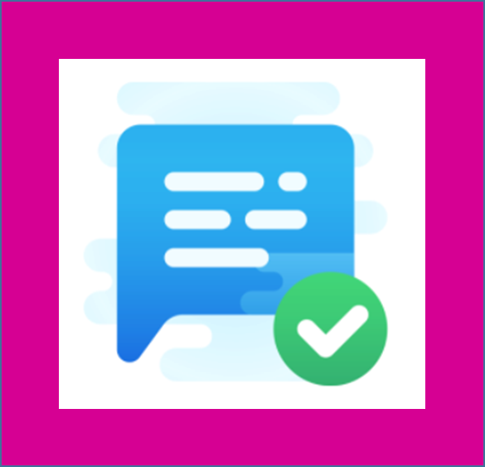
Q4. Which statement is least likely to ensure that online sources are trustworthy? Pick 1 answer below
They are on a website which ends with .com, .org, .net, .co.uk, .eu, .lt, .es, .de
They are objective and back up any claims they make with facts that can be checked
It’s easy to see information about who wrote the content, the source of the information and when it was posted
Choose this answer
Choose this answer
Choose this answer

Slide 19
Q4 Results: Here is how you did
Q4. Which statement is least likely to ensure that online sources are trustworthy?
Your answer was correct.
The correct answer is:
Just because online sources are published on a website which ends with .com, .org, .net, .co.uk, .eu, .lt, .es, .de is no guarantee that it is trustworthy.
(Anyone can buy a domain name)
Find out more

Slide 20
Q4. Learn and Discuss
Well done if you got it right! If you found that a bit tough, just remember – you should always do a fact check on the source.
Trustworthy news sites often have important rules they have to follow before putting information out to the public such as checking for bias and objectivity.
Personal blogs and video channels may not have as many rules so we need to apply more checks on those to make sure what they are sharing is true.

Slide 21
Q4. DISCUSSION
Before you move onto the next question, discuss the following to think about your own experiences:
If you were looking to find information about the price of the latest video games on a particular console, what source would you use?
What about reviews of the game to see if you should buy it – which reviews would you trust?
Next Question

Slide 22
Q4. Results: Here is how you did
Q4. Which statement is least likely to ensure that online sources are trustworthy?
Your choice was not correct.
The correct answer is:
Just because online sources are published on a website which ends with .com, .org, .net, .co.uk, .eu, .lt, .es, .de is no guarantee that it is trustworthy.
(Anyone can buy a domain name)
Find out more

Slide 23
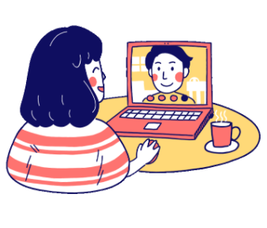
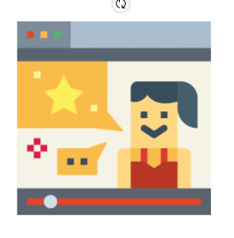
Q5. You've just seen a video of a famous celebrity saying she will give all her money to her millions of fans. It looks real but you're not sure, how do you check if it is? Pick the answer that is not correct
See if the video has been shared on the celebrity’s verified account
Have a look to see who has shared this and think about what their intentions may be
Check if the video has been shared on other blogs you follow
Choose this answer
Choose this answer
Choose this answer

Slide 24
Q5 Results: Here is how you did
Q5. You've just seen a video of a famous celebrity saying she will give all her money to her millions of fans. It looks real but you're not sure, how do you check if it is? Your answer was correct.
You are right! It would NOT be correct assume it is true simply because a video has been shared on other blogs you follow. Just it has been shared doesn’t mean its true!
The RIGHT way to check it would be to:
See if the video has been shared on the celebrity’s verified account; and
Have a look at who has shared it and think about what their intentions may be
Find out more

Slide 25
Q5. Learn and Discuss
More and more people are creating what is known as ‘deep fakes’ which are when technology is used to replicate live facial movements of a person in a video and audio to make it seem real. Some of these videos have gone viral because they are so believable.
Some could also be undercover ads, meant to draw your attention to a certain product or brand. Just because something has gone viral does not make it true. So if it looks like it’s out of the ordinary, do more checks or ask a trusted adult if you’re not sure.
To make sure you don’t fall for these types of misinformation, checking the source and the intentions behind why someone would share it is key.

Slide 26
Q5. DISCUSSION
You’ve come to the end of this quiz, but before you move onto the next quiz, discuss the following to think about your own experiences:
What would convince you a video was real?
FINISH QUIZ

Slide 27
Q5 Results: Here is how you did
Q5. You've just seen a video of a famous celebrity saying she will give all her money to her millions of fans. It looks real but you're not sure, how do you check if it is? Your answer was not correct because you chose something you should do!
The RIGHT things to do are:
See if the video has been shared on the celebrity’s verified account; and
Have a look at who has shared it and think about what their intentions may be
It would NOT be correct to simply check if the video has been shared on other blogs you follow. Just it has been shared doesn’t mean its true!
Find out more

Slide 28
Quiz 2: Spot the difference: Fact or Fake?
Well done for completing the quiz!
How did you do? What was your score?
Check out Quiz 3: Fact Checking Detective to further test your knowledge and learn more

